Slide 1
Java SE 8 Book Presentation
Chapter 6 – Working with Java Operators

Slide 2
6.1 Java Operators – 6.1.1 Overview of available operators in Java
Assignment Operators rules:
- They are all “right associative”, which means ”a = b = c = 10;” will be evaluated as ”c = 10” -> “b =c” -> “a = b”
The left of the operands must be a variable => “a = 10;” is valid while “10 = a;” isn’t valid since 10 is a literal not a variable. But more importantly, we can’t do “someMethod() = 10;” because a method will return a value or an address to an object for reference variable but NOT THE VARIABLE ITSELF
The RHS of the assignment must be an expression where the type is ”compatible” with the target variables (could be the same type or fit with the size of the variable). Compatibility between primitive datatypes is easy to understand (Boolean can’t go with int), however, some reference datatypes are compatible with each other since it has OOP features – Inheritance and Polymorphism (Upcast – Downcast)

Slide 3
6.1 Java Operators – 6.1.2 Expressions and Statements
An “expression” is a combination of operators, explicit values, constants, variables, and functions that the programming language interprets (according to its particular rules of precedence and association) and computes to produce (or “return”) in a stateful environment another value.
The important point here is that an expression has a value (either primitive or reference)
A “statement” is a complete line of code that may or may not store any values of its own => Therefore, an expression could also be a valid statement (CODE ILLUSTRATION – Section6_1_2)

Slide 4
6.1 Java Operators – 6.1.3 Post and Pre Unary Increment/Decrement operators
The “++” and “—” operators can be applied to the variable in “postfix” and ”prefix” forms. This operator will either increase or decrease the variable's value by 1.
The Postfix operator returns the original value of the variable while the prefix operator returns the updated value of the variable (code illustration snippets 1 and 2)
The Unary Increment and Decrement operators are composed of 2 parts:
+) The first part is the expression “i++”
+) The second part is the assignment to the variable ”post” using the assignment operator
(code illustration snippets 3 and 4)
- Using Unary Increment/Decrement on wrapper object is the same as primitive data types. However, it will create a new object with an increased or decreased value based on the operator we used. (code illustration snippet 5)

Slide 5
6.1 Java Operators – 6.1.4 String concatenation using “+” and “+=“ operators
The ”+” and “+=” operators can perform mathematical operations and String concatenation operations.
The behavior of these operators changes based on the operands that we are working
If no String operands are detected, mathematical operations will be executed
If there is AT LEAST 1 String operand detected, String concatenation will be executed (if one of the operands is String and other operands are non-String => the non-String operand will be converted to String operand => the concatenation will be executed) (code illustration snippet 6)
When concatenating String variable to a non-String variable, a special method called “toString()” from class “java.class.Object” will be invoked with the non-String variable. This method is used to create a String representation for the object.
If the variable is primitive, it will be transformed into wrapper object and then call the method “toString()” (code snippet 7)
(code illustration snippet 8)
The ”+” operator will check whether the non-String variable is ”null” or not. If it is “null”, a String “null” will be concatenated with the String variable
”+=“ operator will only work if the left of the expression is a String variable (the left side could be any variable type) (code illustration snippet 9 – 10)

Slide 6
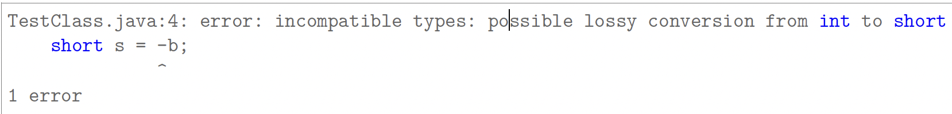
6.1 Java Operators – 6.1.5 Numeric promotion and casting
(Code illustration snippet 11)
Everyone will think this code will produce -1, however, when we compile this code, we will get this error:
- Another problem arise when we have a deeper look inside this error message: Where does “int” come from ? The problem is we only use “byte” and “short” in this situation.
– The reason is that Java has applied a rule called “numeric promotion” when doing operations on numeric value
There are 2 types of promotion in Java “Unary Numeric Promotion” and “Binary Numeric Promotion”
+) Unary Numeric Promotion: If a Unary Operator is working with a numeric variable that has a variable type smaller than the size of “int” => That variable will be transformed or “promoted” to “int”
+) Binary Numeric Promotion: In an expression, if one in two operands has a size that is smaller than “int” => All other operands will be promoted to “int”. If one in two operands has a size larger than ”int” => all operands will be promoted to the current types of the operand that is larger than ”int”
(code illustration snippet 12)
- Even if the source variable has a value size that fits with the target variable size, these codes aren’t compilable since compiler can’t execute code, therefore, it doesn’t know whether the size is correct or not. In these cases, compile time constant and explicit narrowing is required (code illustration snippet 13)

Slide 7
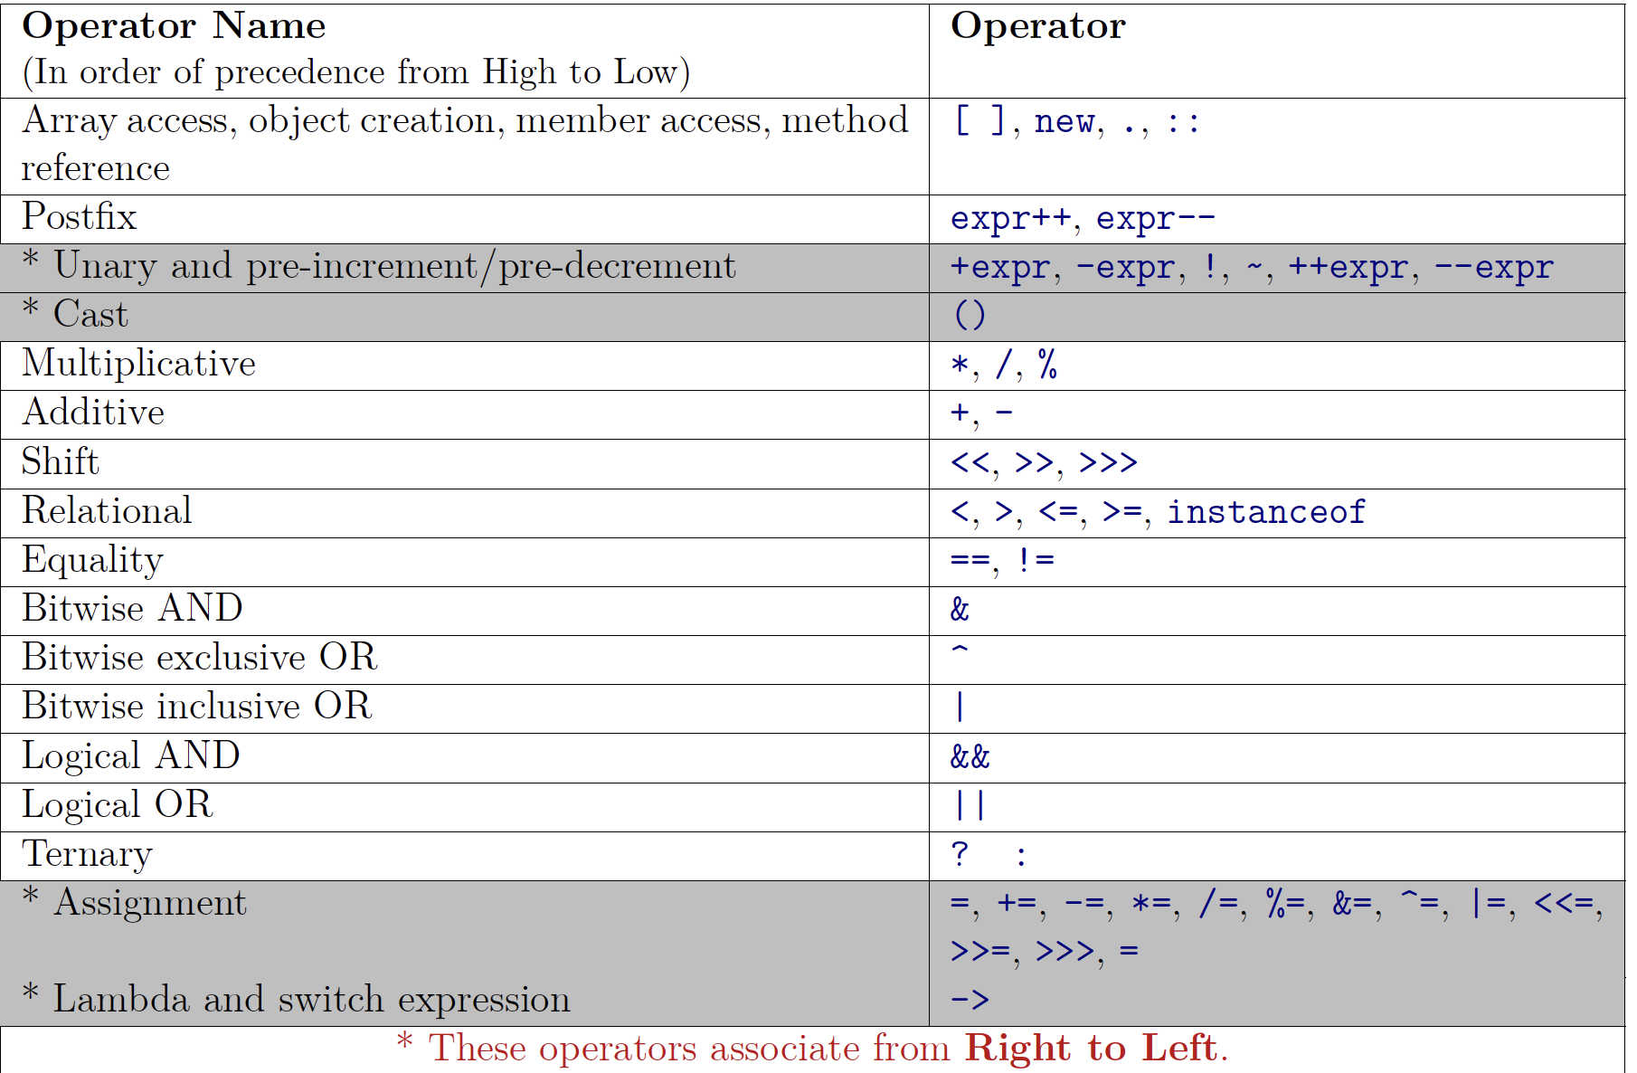

6.1 Java Operators – 6.1.6 Operator precedence and evaluation of expression
I) Precedence
Precedence will determine which operator will be used first in an expression. Moreover, it will also decide which operands would go with the operator that has the highest precedence. (code illustration snippet 14)

Slide 8
6.1 Java Operators – 6.1.6 Operator precedence and evaluation of expression
II) Associativity
This will determine the grouping of operands if all operators have the same precedence
All operators in Java are “left-associative” (e.g: lambda operator, assignment operator, ternary operator)
(code illustration snippet 15)
We could also use parentheses to change the grouping of operands if the default grouping (based on operator precedence and associativity) isn’t what we want
In Java, the expression will be evaluated from left to right (e.g: “GetA() – GetB() + GetC()”, from left to right, GetA() will be evaluated first and then GetB() and then GetC() => If the invocation of GetA() results in an Exception, GetB() and GetC() won’t be invoked too)
Even if, we use parentheses to change the grouping of operands, the evaluation order will still maintain the same
(code illustration snippet 16)

